Slide 1
HTML/CSS
Dung Ho
dho38@dxc.com
Jan 08 2016
Notes:
This file has been revised on June 11 2015 for more information.
https://hocwebchuan.com/reference/tag/tag_doctype.php#doctype
https://hocwebchuan.com/reference/tag/valid_doctype.php#doctype

Slide 2
Introduction
Your role
Your background and experience in the subject
What do you want from this course

Slide 3

Course Objectives
At the end of the course, you will have acquired sufficient knowledge to:
Write a basic web page.
Create simple form with different input text,checkbox, email …
Be ready to start to learn on java script course
Decorate the html with CSS.

Slide 4
Course Audience and Prerequisite
Course Audience:
suitable for those who wish to acquire initial web development knowledge as a first step into web development practices.
Also suitable for individuals with a general web development interest.
Course pre-requsite:
None

Slide 5
Assessment Disciplines
Class Participation: <100%>
Passing Scores: <70%>

Slide 6
Agenda
I. | Introduction to HTML
II. | HTML Working with text
III. | HTML links
IV. | HTML Images
V. | HTML Lists
VI. | HTML Talbes
VII. | HTML Forms
VIII. | Styling HTML with CSS
IX. | Introduce to HTML5/CSS3

Slide 7
HTML INTRODUCTION

Slide 8
HTML INTRODUCTION
What is HTML
HTML versions
HTML tags
HTML Structure
HTML Attribute ( lang , title, href, size and alt )
Void Elements and Comments
Viewing the HTML Source Code in A Browser

Slide 9
HTML INTRODUCTION
What is HTML?
Markup language for describing web documents (web pages).
HTML stands for Hyper Text Markup Language
Notes:
What is HTML?
HTML is a markup language for describing web documents (web pages).
HTML stands for Hyper Text Markup Language
A markup language is a set of markup tags
HTML documents are described by HTML tags
Each HTML tag describes different document content

Slide 10
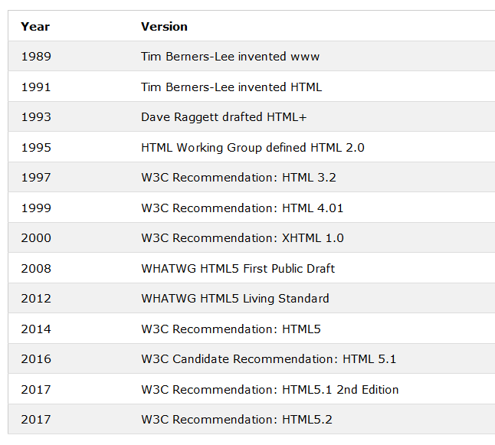
HTML Versions
Version of HTML

Slide 11
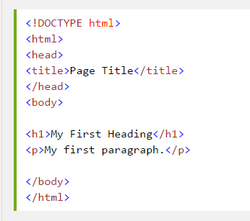
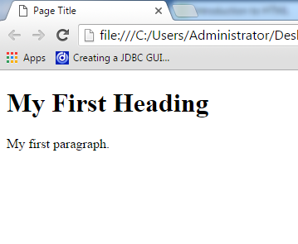
HTML Introduction
Example
Browser
Simple html page
Notes:
<!DOCTYPE html> <html> <head> <title>Page Title</title> </head> <body> <h1>My First Heading</h1> <p>My first paragraph.</p> </body> </html>
The DOCTYPE declaration defines the document type to be HTML
The text between <html> and </html> describes an HTML document
The text between <head> and </head> provides information about the document
The text between <title> and </title> provides a title for the document
The text between <body> and </body> describes the visible page content
The text between <h1> and </h1> describes a heading
The text between <p> and </p> describes a paragraph
Using this description, a web browser can display a document with a heading and a paragraph.

Slide 12
HTML tags
Keywords (tag names) surrounded by angle brackets:<tagname>content</tagname>
Normally come in pairs like <p> and </p>
Start/opening tag & end/closing tag
Notes:
HTML tags are keywords (tag names) surrounded by angle brackets:<tagname>content</tagname>
HTML tags normally come in pairs like <p> and </p>
The first tag in a pair is the start tag, the second tag is the end tag
The end tag is written like the start tag, but with a slash before the tag name
Note : The start tag is often called the opening tag. The end tag is often called the closing tag.

Slide 13
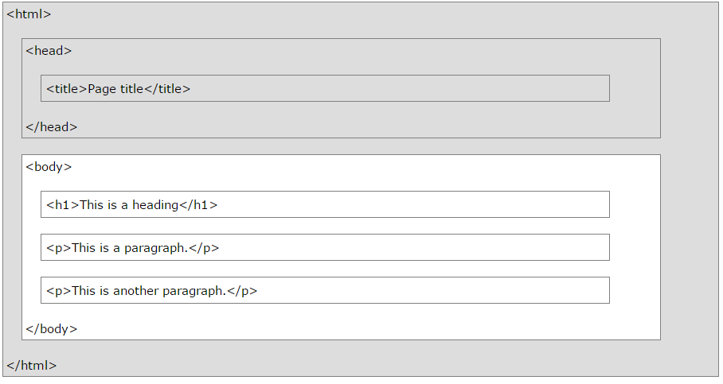
HTML Page Structure
HTML structure

Slide 14

HTML Attributes
Provide additional information about an element
Always ="value"
specified in the start tag
Come in name/value pairs like: name
HTML attribute
Notes:
HTML elements can have attributes
Attributes provide additional information about an element
Attributes are always specified in the start tag
Attributes come in name/value pairs like: name="value"

Slide 15
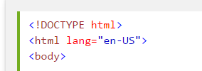
The lang Attribute
The document language can be declared in the <html> tag.
The language is declared in the lang attribute.
The lang attribute
Notes:
https://www.sitepoint.com/iso-2-letter-language-codes/

Slide 16
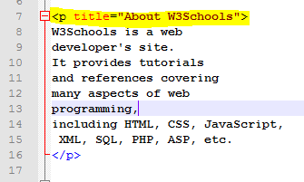
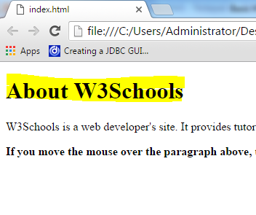
The title Attribute
The title Attribute
Browser
The title attribute
Notes:
HTML paragraphs are defined with the <p> tag.
<p> element has a title attribute
Tag <p> định nghĩa một đoạn văn bản.
Tag <p> tự động tạo một khoảng trắng trước và sau nó, khoảng trắng này tùy trình duyệt sẽ khác nhau.

Slide 17
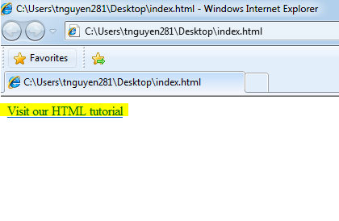


The href Attribute
The href attribute
Browser:
The href attribute

Slide 18
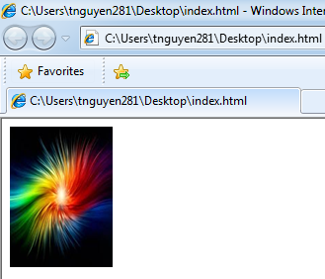

Size Attributes and alt Attributes
Size and alt Attribute
Browser
The size and alt attribute
Notes:
HTML images are defined with the <img> tag
<img src="w3schools.jpg" width="104" height="142">
The image size is specified in pixels: width="104" means 104 screen pixels wide
The alt attribute specifies an alternative text to be used, when an HTML element cannot be displayed.
<!DOCTYPE html>
<html>
<body>
<img src="C:\Users\tnguyen281\Desktop\Example.jpg"
alt="Example Image"
width="104" height="142">
</body>
</html>

Slide 19
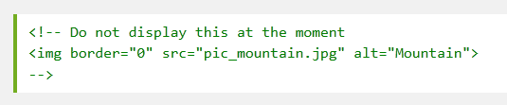
Void Elements and Comments
Elements with no content.
Can be written without an end tag (<br> or <br/>)
Use <!-- and -- > for comments
Comments elements
Notes:
Not all HTML elements can have content. Void elements cannot have content, even though they can have attributes. Here are void elements: area, base, br, col, command, embed, hr, img, input, keygen, link, meta, param, source, track and wbr.
A void element can be written without an end tag ( <br> or <br/>)
In complex pages, it is a good idea to add comments. A comment starts with <!-- and ends with -->. HTML comments are not rendered.

Slide 20
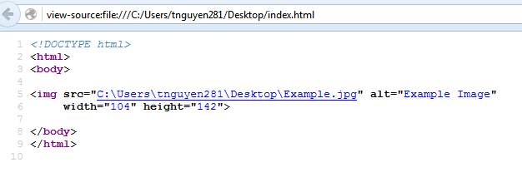
Viewing the HTML Source Code in A Browser
Why we need to view HTML source code ?
Chrome and Firefox: CTRL + U.
Internet Explorer : right click + View source.
Firefox source view
Notes:
Most browsers allow you to view the source code for a web page. There are two reasons why you would want to do that.
To learn from others how they built their web pages.
To verify HTML tags are being generated correctly when using a programming language to dynamically build web pages.
In Chrome and Firefox, you can press the CTRL+U to view an HTML source. In Internet Explorer, right-click on the page and select View Source.

Slide 21
HTML working with text
Paragraphs
Headings
White Spaces
b and i Elements
code and pre Elements

Slide 22
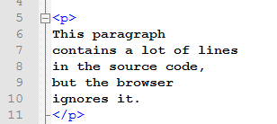
HTML Paragraphs- HTML Display
<p> element defines a paragraph.
How Browser display ?
Remove extra spaces and line.
Any number of spaces/new lines as only one space
Notes:
The browser will remove extra spaces and extra lines when the page is displayed.
Any number of spaces, and any number of new lines, count as only one space.

Slide 23

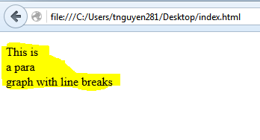
HTML line break br
<br> element defines a line break.
Paragraph and line break example
Notes:
HTML documents are divided into paragraphs.
The HTML <p> element defines a paragraph.
Browsers automatically add an empty line before and after a paragraph.
The browser will remove extra spaces and extra lines when the page is displayed.
Any number of spaces, and any number of new lines, count as only one space.
The HTML Use <br> if you want a line break (a new line) without starting a new paragraph

Slide 24
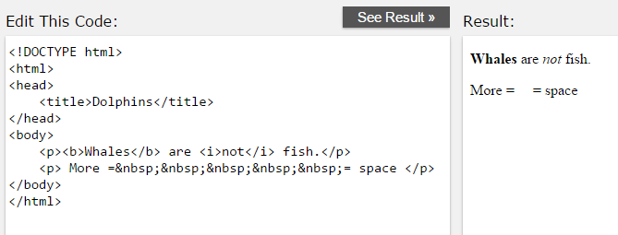
HTML White Spaces - b and i Elements
White space : &nbsp;
b and i element are used to present text in bold and italicized formats
White space , b and I elements

Slide 25
HTML Working with Text
HTML Italic and Emphasized Formatting
<i> element defines italic text, without any extra importance.
<em> element defines emphasized text, with added semantic importance.
HTML Bold and Strong Formatting
<b> element defines bold text, without any extra importance.
<strong> element defines strong text, with added semantic "strong" importance.
Notes:
Thẻ <b> như bạn nói sẽ in đậm văn bản bên trong phần tử. nó tương đương với sử dụng thẻ <span> với thuộc tính font-weight: bold trong CSS.
Còn thẻ <strong> được dùng để nhấn mạnh ý nghĩa của văn bản bên trong thẻ so với các văn bản khác. Mặc dù trình duyệt cũng sẽ in đậm văn bản bên trong thẻ này tuy nhiên mục đích chính của <strong>là nhấn mạnh ý nghĩa của văn bản hơn là để hiển thị in đậm văn bản. Các công cụ tìm kiếm như Google sẽ nhấn mạnh văn bản trong thẻ <strong>hơn văn bản sử dụng <b> hoặc <span> với thuộc tính font-weight: bold;.

Slide 26
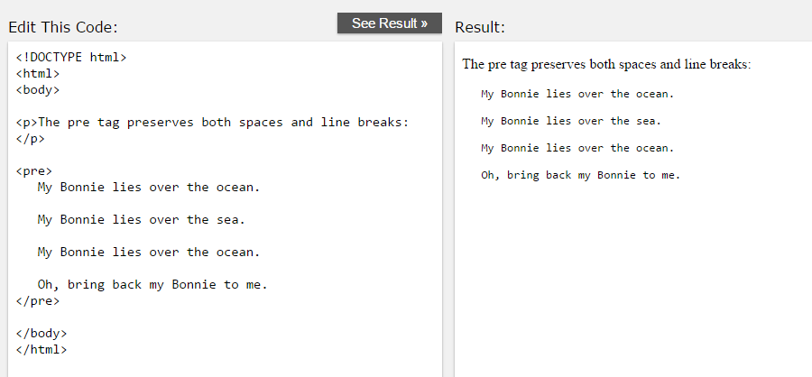
HTML Paragraphs - pre Element
The HTML <pre> element defines preformatted text.
Preserves both spaces and line breaks
Pre element

Slide 27
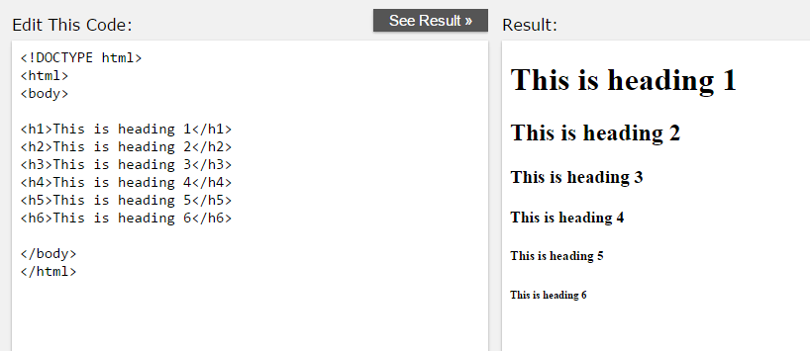
HTML Headings
Headings are defined with the <h1> to <h6> tags.
<h1> defines the most important heading. <h6> defines the least important heading.
Headings

Slide 28
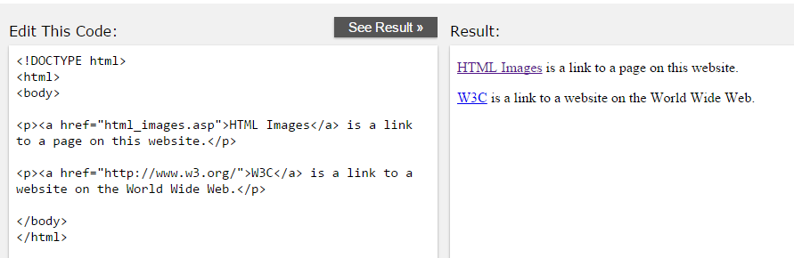
HTML Links
HTML links are hyperlinks.
A hyperlink is a text or an image you can click on, and jump to another document.
Defined with the <a> tag. <a href="url">link text</a>
Link example
Notes:
A hyperlink is a text or an image you can click on, and jump to another document.

Slide 29

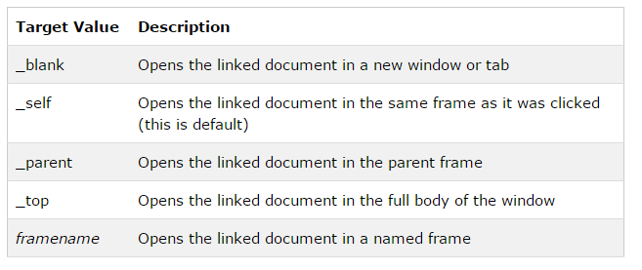
HTML Links -The target Attribute
Target attribute
Notes:
https://www.youtube.com/watch?v=f47cmY9LtM4
- Thẻ <frame> xác định một khung trong một bộ khung, nó dùng để nhúng một tài liệu nào đó vào trang web hiện tại (tài liệu ở đây rất đa dạng, có thể là một trang web khác, tập tin pdf, tấm hình, ....)
- Thẻ <frame> bắt buộc phải được đặt bên trong phần tử <frameset>
Thẻ <frame> có ba thuộc tính cơ bản.
Src Xác định đường dẫn đến tài liệu mà bạn muốn đặt vào khung
Scrolling Xác định việc có nên hiển thị các thanh scroll hay không
Noresize Ngăn chặn hành động kéo thả làm thay đổi kích thước của phần tử <frame>
https://www.youtube.com/watch?v=wcfoVffDwdA
http://webcoban.vn/html/cach-chen-iframe-khung-trang-web-vao-trang-web.html
Khung là một phần tử được tạo nên bởi thẻ <iframe>, nó có chức năng gần giống với một cái Tab trên trình duyệt, đó chính là dùng để mở & thao tác với trang web.
The difference is an iframe is able to "float" within content in a page, that is you can create an html page and position an iframe within it. This allows you to have a page and place another document directly in it. A frameset allows you to split the screen into different pages (horizontally and vertically) and display different documents in each part.

Slide 30
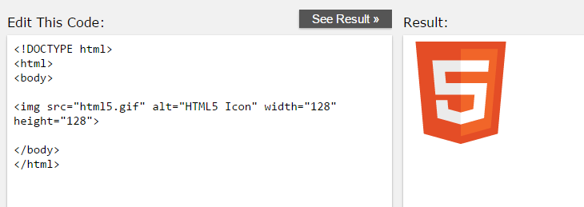
HTML Images
Images are defined with the <img> tag.
Void element
Use alt attribute for alternate text.
Image example
Notes:
In HTML, images are defined with the <img> tag.
The <img> tag is empty, it contains attributes only, and does not have a closing tag.
The alt attribute specifies an alternate text for an image, if the image cannot be displayed.

Slide 31
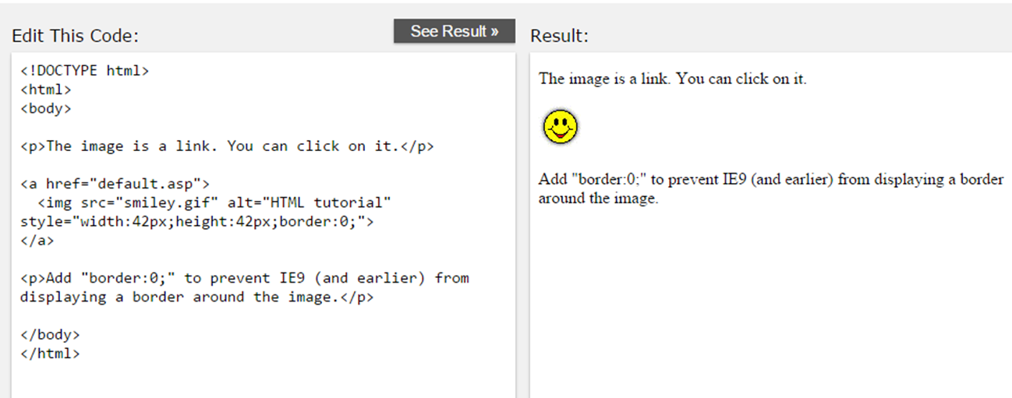
HTML Images
To use an image as a link, simply nest the <img> tag inside the <a> tag
Image as a link

Slide 32
HTML Lists
Unordered HTML Lists
Ordered HTML Lists

Slide 33
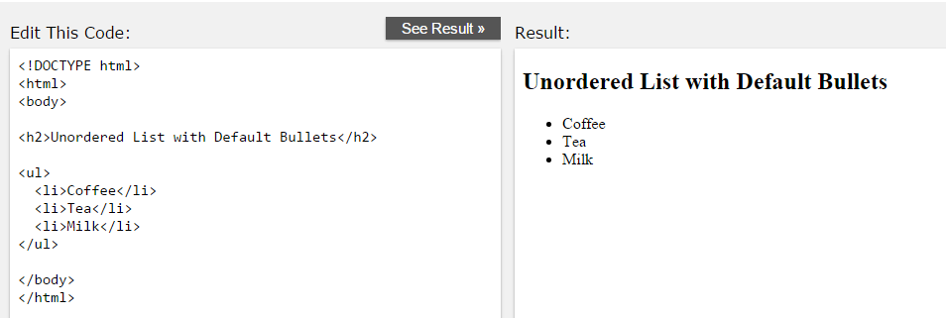
Unordered HTML Lists
An unordered list starts with the <ul> tag. Each list item starts with the <li> tag.
Unordered lists
Notes:
An unordered list starts with the <ul> tag. Each list item starts with the <li> tag.
The list items will be marked with bullets (small black circles)

Slide 34
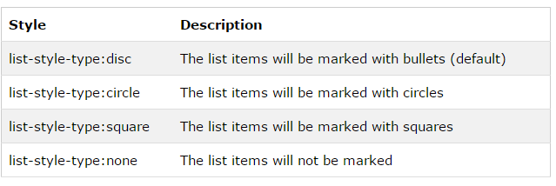
Unordered HTML Lists - The Style Attribute
Unordered list attribute
Notes:
A style attribute can be added to an unordered list, to define the style of the marker:

Slide 35
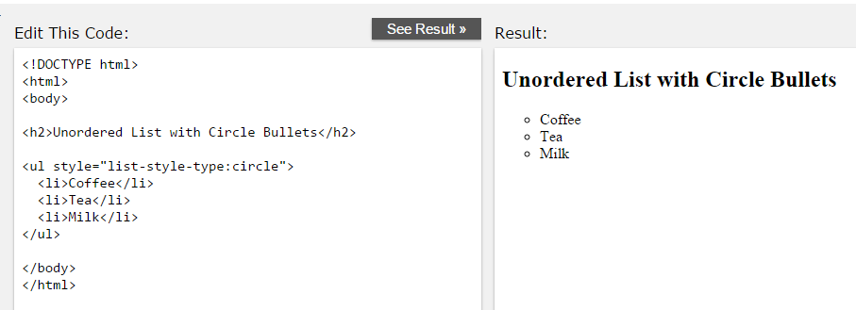
Unordered HTML Lists –Circle style
Unordered Circle style lists

Slide 36
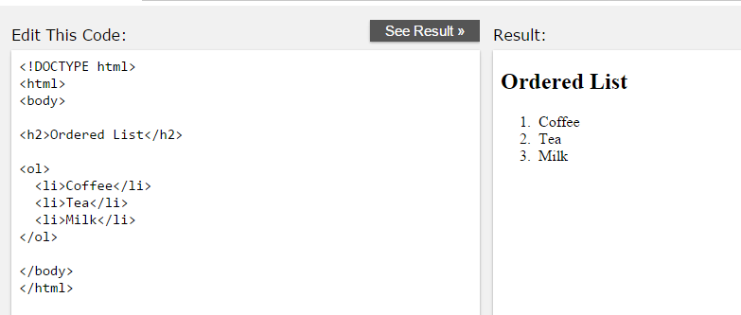
Ordered HTML Lists
An ordered list starts with the <ol> tag. Each list item starts with the <li> tag.
The list items will be marked with numbers:
Ordered lists

Slide 37
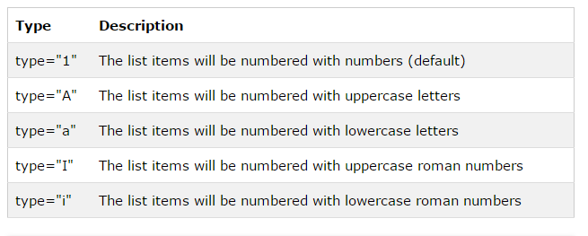
Ordered HTML Lists - The Type Attribute
Ordered list attribute
Notes:
A type attribute can be added to an ordered list, to define the type of the marker:

Slide 38
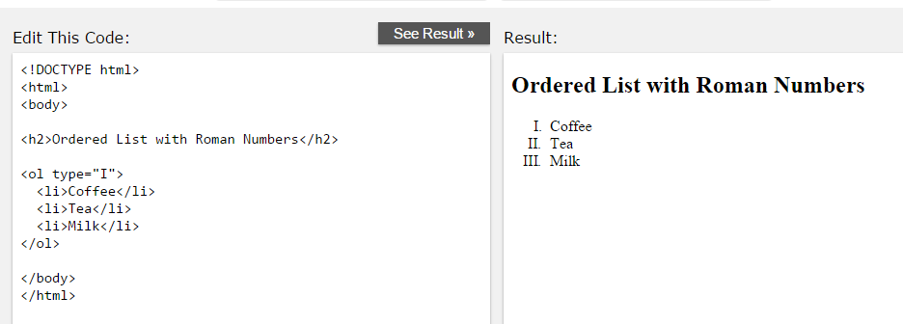
Uppercase Roman Numbers
Ordered lists – uppercase Roman style

Slide 39
HTML tables

Slide 40
HTML tables
Tables are defined with the <table> tag.
Tables are divided into table rows with the <tr> tag.
Table rows are divided into table data with the <td> tag.
A table row can also be divided into table headings with the <th> tag.
Table data <td> are the data containers of the table.
Notes:
Tables are defined with the <table> tag.
Tables are divided into table rows with the <tr> tag.
Table rows are divided into table data with the <td> tag.
A table row can also be divided into table headings with the <th> tag.
Table data <td> are the data containers of the table.
They can contain all sorts of HTML elements like text, images, lists, other tables, etc.

Slide 41
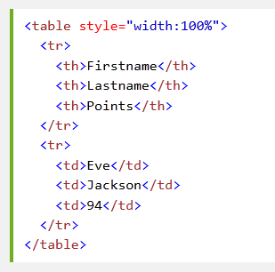
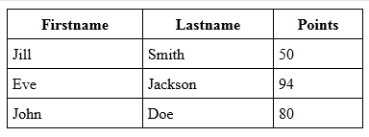
HTML tables
Table element
Browser
Table example

Slide 42
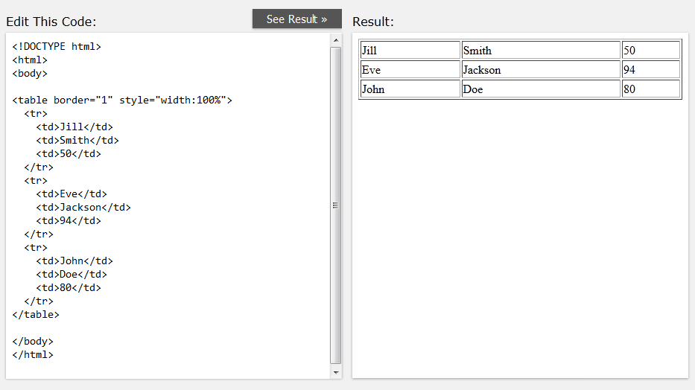
An HTML Table with a Border Attribute
Not specify a border table will be displayed without borders.
Using the border attribute to add border.
Table - border attribute

Slide 43
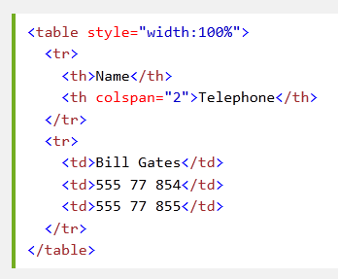

Table Cells that Span Many Columns
Table –split columns
Notes:
To make a cell span more than one column, use the colspan attribute

Slide 44
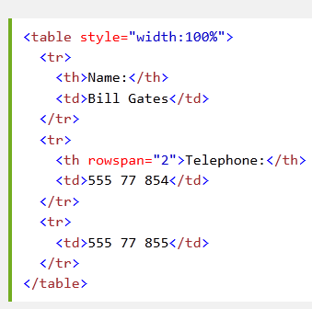
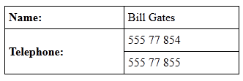
Table Cells that Span Many Rows
Table –split rows
Notes:
To make a cell span more than one row, use the rowspan attribute

Slide 45
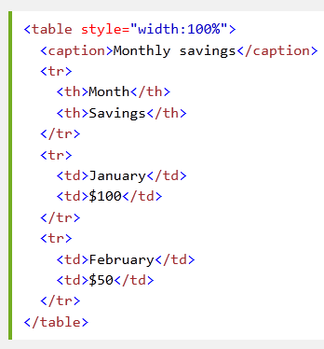
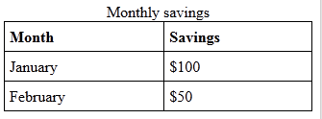
An HTML Table With a Caption
Table – Caption
Notes:
To add a caption to a table, use the <caption> tag

Slide 46
HTML Forms

Slide 47
HTML Forms
The <form> element defines an HTML form:
<form>
…form elements
</form>
Form elements are different types of input elements, checkboxes, radio buttons, submit buttons, and more.
Notes:
HTML forms are used to collect user input.
HTML forms contain form elements.

Slide 48
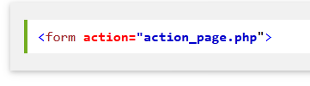
Form element - The Action Attribute
The action attribute defines the action to be performed when the form is submitted.
Using submit button to submit form to a server ( web page or web server).
If the action attribute is omitted, the action is set to the current page.
Form – action
Notes:
The action attribute defines the action to be performed when the form is submitted.
The common way to submit a form to a server, is by using a submit button.
Normally, the form is submitted to a web page on a web server.
If the action attribute is omitted, the action is set to the current page.

Slide 49
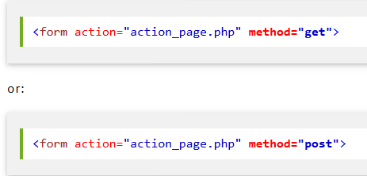
Form element- The Method Attribute
The method attribute specifies the HTTP method (GET or POST) to be used when submitting the forms
Form – method

Slide 50
Form element- The Method Attribute
When to use GET (default method)?
Without sensitive information
When you use GET, the form data will be visible in the page address
action_page.php?firstname=Mickey&lastname=Mouse
When to Use POST?
updating data, or includes sensitive information (password).
POST offers better security.

Slide 51
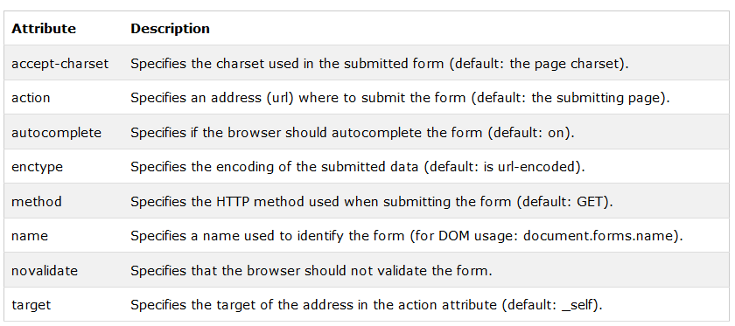
HTM Form Attributes
Form attributes
Notes:
https://www.codehub.vn/Phan-Biet-Character-Set-va-Character-Encoding
https://hocwebchuan.com/reference/tag/tag_form.php
https://hocwebchuan.com/reference/tag/valid_doctype.php#doctype
https://www.w3schools.com/tags/att_form_autocomplete.asp
https://www.ducanhplus.com/html-va-xhtml-giong-va-khac-nhau/
https://freetuts.net/dom-la-gi-cac-loai-dom-trong-javascript-366.html
https://www.w3schools.com/tags/att_form_enctype.asp
accept-charset: accept-charset="ISO-8859-1“Chỉ định cụ thể bộ dữ liệu (character-sets) mà máy chủ có thể xử lý cho form dữ liệu. Không được hỗ trợ trong trình duyệt IE
Text luôn là một chuỗi bit cần được dịch ra text con người có thể đọc được bằng cách sử dụng các bảng tra cứu. Nếu dùng sai bảng, ký tự sai sẽ được sử dụng.
Bạn không thực sự làm việc với "ký tự" hay "văn bản", bạn luôn làm việc với bitthông qua hàng loạt lớp trừu tượng. Thường thì bạn sẽ gặp vấn đề nếu một trong các lớp trừu tượng này bị sai.
Nếu 2 hệ thống giao tiếp với nhau, chúng luôn cần biết được việc sử dụng encoding nào. Một ví dụ đơn giản nhất là trang web báo cho trình duyệt biết việc nó được mã hoá bằng UTF-8.
Trong thời đại ngày nay, encoding tiêu chuẩn chính là UTF-8, do nó có thể mã hoá gần như mọi ký tự bạn cần, tương thích ngược với và khá hiệu quả về mặt bộ nhớ đối với hầu hết các trường hợp.
Enctype: Chỉ định cụ thể dạng dữ liệu gì trước khi gửi lên máy chủ. https://www.w3schools.com/tags/att_form_enctype.asp
Method: Chỉ định cụ thể gửi dữ liệu bằng phương thức gì (Get/ Post) https://www.w3schools.com/tags/att_form_method.asp
Name: Chỉ định tên cho form. Không được hỗ trợ trong DTD Strict https://www.w3schools.com/tags/att_form_name.asp
Novalidate: https://www.w3schools.com/tags/tryit.asp?filename=tryhtml5_form_novalidate
Target: https://www.w3schools.com/tags/tryit.asp?filename=tryhtml_form_target

Slide 52
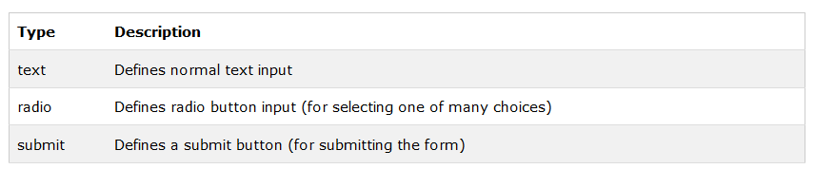
HTM Forms – The <input> Element
The <input> element is the most important form element.
The <input> element has many variations, depending on the type attribute.
Popular input element

Slide 53
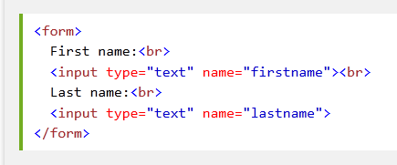
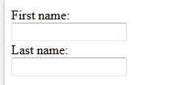
HTM Forms – The <input> Element
Text Input
<input type="text"> defines a one-line input field for text input
Form - Input example

Slide 54
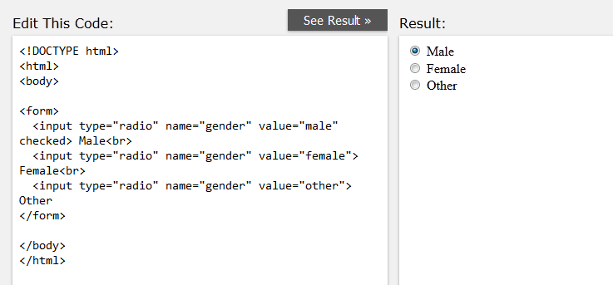
HTM Forms – The <input> Element
Radio Button Input
Radio buttons let a user select ONE of a limited number of choices
Radio button
Notes:
https://www.w3schools.com/tags/tryit.asp?filename=tryhtml5_input_type_radio

Slide 55
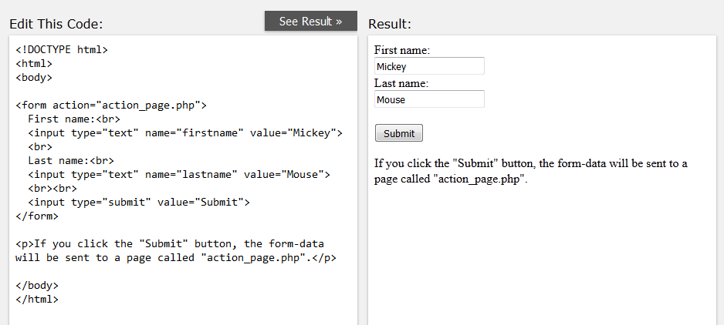
HTM Forms – The <input> Element
The Submit Button
<input type="submit"> defines a button for submitting a form.
Form – submit button

Slide 56
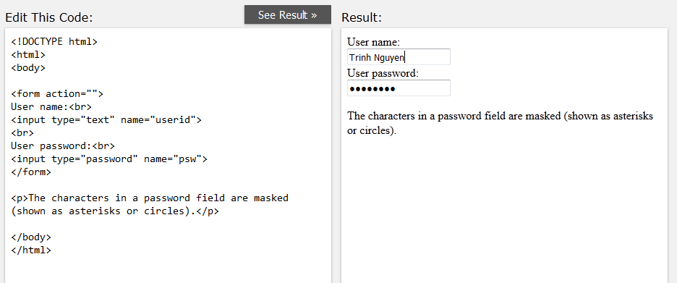
HTM Forms – The <input> Element
Input Type: password
<input type="password"> defines a password field
Form – password input

Slide 57
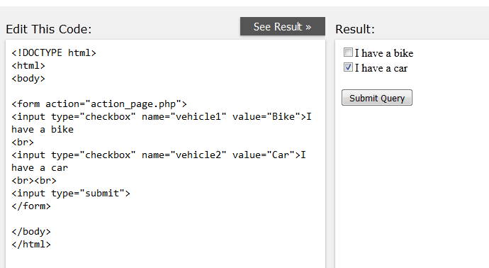
HTM Forms – The <input> Element
Input Type: checkbox
<input type="checkbox"> defines a checkbox.
Checkboxes let a user select ZERO or MORE options of a limited number of choices.
Form – checkbox input
Notes:
https://www.w3schools.com/tags/tryit.asp?filename=tryhtml5_input_type_checkbox

Slide 58
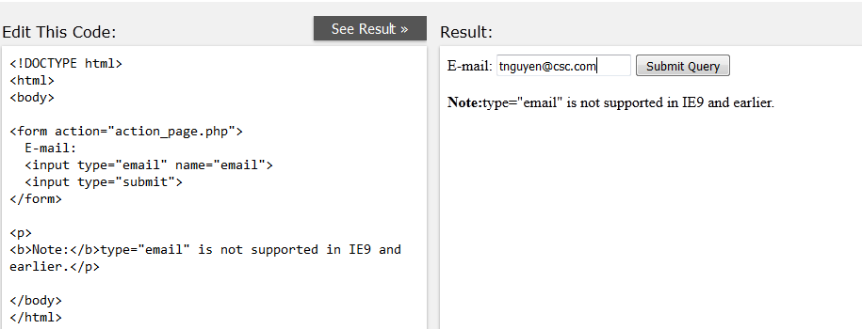
HTM Forms – The <input> Element
Input Type: email
The <input type="email"> is used for input fields that should contain an e-mail address.
Depending on browser support, the e-mail address can be automatically validated when submitted.
Form – email input

Slide 59
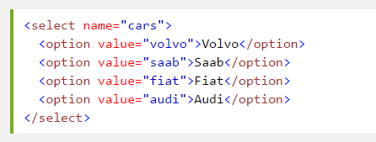
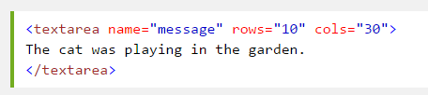
HTML Form: Drop-down and Text Area
<select> element defines a drop-down
Drop-down example
<textarea> element defines a multi-line input field
textarea example
Notes:
https://www.w3schools.com/tags/tryit.asp?filename=tryhtml_select_name
https://www.w3schools.com/tags/tryit.asp?filename=tryhtml_textarea

Slide 60
Styling HTML with CSS

Slide 61
Styling HTML with CSS
CSS stands for Cascading Style Sheets
Styling can be added to HTML elements in 3 ways:
Inline - using a style attribute in HTML elements
Internal - using a <style> element in the HTML <head> section
External - using one or more external CSS files
The most common way to add styling, is to keep the styles in separate CSS files.

Slide 62
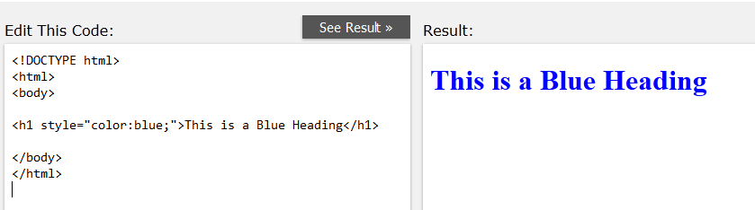
Styling HTML with CSS
Inline Styling (Inline CSS)
Inline styling is used to apply a unique style to a single HTML element:
Inline styling uses the style attribute.
This example changes the text color of the <h1> element to blue:
Inline Styling

Slide 63
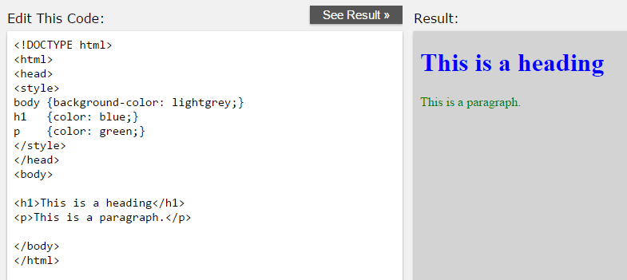
Styling HTML with CSS
Internal Styling (Internal CSS)
Internal styling is used to define a style for one HTML page.
Internal styling is defined in the <head> section of an HTML page, within a <style> element:
Internal Styling

Slide 64
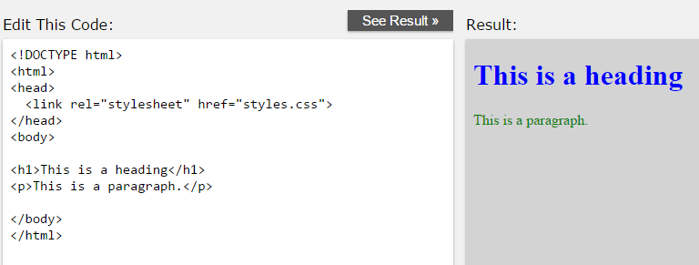

Styling HTML with CSS
External Styling (External CSS)
used to define the style for many pages.
Able to change the look of an entire web site by changing one file!
Use /* for begin comment and */ for close comment.
External Styling
Notes:
External Styling (External CSS)
An external style sheet is used to define the style for many pages.
With an external style sheet, you can change the look of an entire web site by changing one file!
To use an external style sheet, add a link to it in the <head> section of the HTML page

Slide 65

Styling HTML with CSS
The id Attribute
To define a special style for one special element:
Add an id attribute to the element:
Then define a different style for the (identified) element:
Id Attribute
Notes:
ID's are unique
Each element can have only one ID
Each page can have only one element with that ID

Slide 66

Styling HTML with CSS
The class Attribute
To define a style for a special type (class) of elements:
add a class attribute to the element:
Define a different style for all elements with the specified class:
class Attribute
Notes:
Classes are NOT unique
You can use the same class on multiple elements.
You can use multiple classes on the same element.

Slide 67
Agenda
I. | Introduction to HTML
II. | HTML Working with text
III. | HTML links
IV. | HTML Images
V. | HTML Lists
VI. | HTML Tables
VII. | HTML Forms
VIII. | Styling HTML with CSS
IX. | Introduce to HTML5/CSS3

Slide 68
HTML5 & CSS3
Trinh Nguyen
tnguyen281@csc.com
Jan 08 2016
Notes:
This file has been revised on June 11 2015 for more information.
https://www.hostinger.vn/huong-dan/khac-biet-giua-html-va-html5/

Slide 69
HTML5

Slide 70
Introduction
What is HTML5?
HTML5 is the latest version of HTML.
HTML5 is a cooperation between the W3C and the WHATWG
It was specially designed to deliver rich content without the need for additional plugins. The current version delivers everything from animation to graphics, music to movies, and can also be used to build complicated web applications.
HTML5 is also cross-platform. It is designed to work whether you are using a PC, or a Tablet, a Smartphone, or a Smart TV.
Notes:
https://labs.septeni-technology.jp/none/nhung-dieu-can-biet-ve-html5/
HTML5 là một chuẩn mới và là thế hệ tiếp theo của ngôn ngữ đánh dấu siêu văn bản – HyperText Markup Language explained (gọi tắt là HTML).
HTML5 là kết quả của sự hợp tác giữa tổ chức W3C và nhóm WHATWG. WHATWG làm việc với các web form và các ứng dụng, còn W3C thì được làm việc với XHTML 2.0. Trong năm 2006, họ quyết định hợp tác và tạo ra một phiên bản mới của HTML, đó chính là HTML5.
-- Giảm thiếu nhu cầu sử dụng các plugins bên ngoài, với HTML5, sẽ không cần đến các công nghệ độc quyền: Ngôn ngữ web HTML5 ra đời nhằm mục đích giảm bớt sự phụ thuộc và cần thiết của những công nghệ ứng dụng Internet độc quyền như Adobe Flash, Microsoft Silverlight và Sun JavaFX.
--Thêm các thể đánh dấu mới để dần thay thế cho các mã lập trình: Điểm đặc trưng đầu tiên của một ngôn ngữ đánh dấu (markup language) là các thẻ. Và ở mặt này thì HTML5 được bổ sung rất nhiều cái mới, từ các thẻ tổ chức nội dung (article, aside, title…) đến các thẻ hỗ trợ tương tác và multimedia (video, audio…). Trong HTML5 cũng xuất hiện một khái niệm gọi là semantic markup, tức là các thẻ có mang ngữ nghĩa. hẻ <form> của HTML5 cũng được xem là một cải tiến lớn. Giờ đây với Form 2.0 (một cách gọi form trong HTML5), tất cả những chức năng mà bạn cần (định dạng, validate data…) đã được xây dựng trực tiếp vào trong HTML.
--Công cụ thiết kế mới: HTML5 và CSS3 cũng làm cho các ứng dụng Web và các trang Web hấp dẫn hơn. HTML5 có các tính năng mới được thêm vào giúp cho việc xây dựng ứng dụng web dễ dàng hơn rất nhiều. Ví dụ như nhiều màu sắc hơn và hỗ trợ đường cong, việc làm mờ, góc tròn (thay vì ép buộc các nhà thiết kế web sử dụng các file ảnh để tạo ra các góc tròn), và dĩ nhiên là cả việc lưu trữ offline.
--Khả năng hoạt động xuyên suốt giữa các trình duyệt

Slide 71
Introduction
A Minimum HTML5 Document
Below is a simple HTML5 document, with the minimum of required tags:
<!DOCTYPE html> <html> <head> <meta charset="UTF-8">
<title>Title of the document</title> </head> <body> Content of the document...... </body> </html>

Slide 72
Introduction
Updated HTML5 elements
HTML 4.01 Transitional:
<!DOCTYPE HTML PUBLIC "-//W3C//DTD HTML 4.01 Transitional//EN" "http://
www.w3.org/TR/html4/loose.dtd">
The meta declaration in HTML4
<meta http-equiv="Content-Type" content="text/html; charset=UTF-8">
In HTML 4.01, we specify the type attribute as text/javascript:
<script type="text/javascript" src="file.js"></script>
The link tag in HTML 4.01:
<link rel="stylesheet" type="text/css" href="file.css">

Slide 73
Introduction
Updated HTML5 elements
<!DOCTYPE html> Always add the !DOCTYPE tag so that the browser knows what type of document to expect.
Meta declaration <meta charset="UTF-8">
Script tag <script src="file.js"></script>
Link tag <link rel="stylesheet" href="file.css">

Slide 74
Introduction
HTML5 Semantic Elements
Tag | Description
<article> | Defines an article in the document
<aside> | Represents content related to the main area of the document. This is usually expressed in sidebars that contain elements like related posts, tag clouds, etc.
<header> | Defines a header for the document or each section contained in the page
<main> | Defines the main content of a document. You should only use this element once per page
<footer> | Defines a footer for the document or each section contained in the page
<nav> | Defines navigation links in the document
<section> | Defines a section in the document
…. | ….
Notes:
Thẻ <section> chia nội dung trang web ra thành nhiều phần chính. Mỗi <section> lại có thể có nhiều <article>. Một <article> có thể xem như một bài viết cụ thể (chẳng hạn như một blog entry rất thích hợp để đặt trong một <article>). Cuối cùng, thẻ <aside> thường đóng vai trò như một sidebar cung cấp các thông tin liên quan cho <article> chứa nó (thực tế thì bạn sẽ cần đến CSS nếu muốn hiển thị thẻ <aside> này như một sidebar).
https://www.w3schools.com/html/html5_new_elements.asp
Thẻ <header> và <footer> đánh dấu phần mở đầu và kết thúc của một trang web, đây là nơi thích hợp để đặt các banner, logo hình ảnh và thông tin bản quyền.

Slide 75

New Semantic/Structural Elements
<section>….</section>
The section element represents a generic document or application section.
It’s used for grouping together thematically related content. It’s not like a div has no semantic meaning, but the section element does.

Slide 76
New Semantic/Structural Elements
<header>….</header>
Usually appears at the top of a document or section
It is defined by its content rather than its position.
There can be many different headers on a page.
Example :
<section>
<header>
<h1>The heading of the section</h1>
<p>This is content in the header.</p>
</header>
<p>This is some information within the section.</p>
</section>

Slide 77
New Semantic/Structural Elements
<footer>….</footer>
Usually appears at the bottom of a document or section
It is defined by its content rather than its position.
There can be many different footer on a page.
Example:
<section>
<header>
<h1>The heading of the section</h1>
<p>This is content in the header.</p>
</header>
<p>This is some information within the section.</p>
<footer>
<p>By "Author Name"</p>
</footer>
</section>

Slide 78
New Semantic/Structural Elements
<aside>….</aside>
An aside element is appropriate when it is used to represent content that is not the primary focus of an article or page, but it is still related to the article or page..
Example :
<section>
<header>
<h1>The heading of the section</h1>
<p>This is content in the header.</p>
</header>
<p>This is some information within the section.</p>
<aside>
<p>Some secondary information.</p>
</aside>
<footer>
<p>By "Author Name"</p>
</footer>
</section>

Slide 79
New Semantic/Structural Elements
<article>….</article>
Determining if a particular piece of content is “self-contained:”
Some uses for the article tag:
A blog post
A news story
A comment on a post
A review

Slide 80
New Semantic/Structural Elements
<main>….</main>
Determining if a particular piece of content is “self-contained:”
The main content area consists of content that is directly related to or expands upon the central topic of a document or central functionality of an application.
Some uses for the main tag:
Do not include more than one main element in a document
Do not include the main element inside of an article, aside, footer, header, or nav element

Slide 81
Introduction
HTML4 structure
div id=header
div id=nav
div id=sidebar
div id=article
div class=section
div class=section

Slide 82
Introduction
Semantic elements in HTML5
Our code become more readable and maintainable.
<header>
<nav>
<aside>
<article>
<section>
<section>
Notes:
Avoiding common HTML5 mistakes
http://html5doctor.com/avoiding-common-html5-mistakes/
http://html5doctor.com/downloads/h5d-sectioning-flowchart.png

Slide 83






Forms
New Input Types
Not all browsers support all the new form elements. However, you can already start using them; If they are not supported, they will behave as regular text fields.

Slide 84




Form
Input type on mobile
Added usability on mobile devices
type="text" | type="number" | type="email" | type="tel"

Slide 85

Form
New form elements
HTML5 has the following new form elements:
<datalist> : Specifies a list of pre-defined options for an <input> element
<input list="browsers" name="browsers">
<datalist id="browsers">
<option value="Internet Explorer">
<option value="Firefox">
<option value="Chrome">
<option value="Opera">
<option value="Safari">
</datalist>
Notes:
https://www.w3schools.com/html/tryit.asp?filename=tryhtml_elem_datalist
We can use datalist with the various types of input – range, color, date, time, datetime-local, ….
http://demo.agektmr.com/datalist/
<input type="range" value="0" min="0" max="100" list="number" /> <datalist id="number"> <option>10</option> <option>15</option> <option>30</option> <option>50</option> <option>90</option> </datalist>
<input type="color" value="#000000" list="color" /> <datalist id="color"> <option>#ff0000</option> <option>#0000ff</option> <option>#00ff00</option> <option>#ffff00</option> <option>#00ffff</option> </datalist>
User can input their own value instead of selecting from the list
We can type more 2 characters into input of datalist – select control can’t

Slide 86
Graphics
What is Canvas?
The HTML5 <canvas> element is used to draw graphics, on the fly, via scripting (usually JavaScript).
The <canvas> element is only a container for graphics. You must use a script to actually draw the graphics.
Canvas has several methods for drawing.
Shapes
Defining paths
Creating gradients
Applying transformations

Slide 87



Graphics
Canvas
Notes:
https://www.w3schools.com/graphics/canvas_drawing.asp
Awesome HTML5 Canvas Animations & Applications:
http://blog.entheosweb.com/ideas/awesome-html5-canvas-animations-applications
fillRect(x,y,width,height)
Canvas 3D
http://www.arc.id.au/Canvas3DGraphics.html

Slide 88

Media
Video
Problem with Flash Player on your device?
Easy to have a video on your page
<video width="500" height="300" controls>
<source src="video\CSC.MP4" type="video/mp4">
<source src="video\CSC.ogg" type="video/ogg">
Your browser does not support the video tag.
</video>

Slide 89

Media
Audio
<audio controls>
<source src="audio/Song.mp3" type="audio/mpeg">
<source src="audio/Song.ogg" type="audio/ogg">
Your browser does not support this audio format.
</audio>

Slide 90


APIs
Geolocation
Figure out where you are in the world by:
Your IP address
Your wireless network connection
Which cell tower your phone is talking to
Dedicated GPS hardware
Where are you?
Notes:
https://www.w3schools.com/html/html5_geolocation.asp
https://www.w3schools.com/html/tryit.asp?filename=tryhtml5_geolocation

Slide 91
CSS3

Slide 92
CSS3
border-radius
.box {
border-top-left-radius: 15px;
border-top-right-radius: 15px;
border-bottom-right-radius: 15px;
border-bottom-left-radius: 15px;
}
.box {
-webkit-border-radius: 0; /* Safari, Chrome */
-moz-border-radius: 0; /* Firefox */
border-radius: 0;
}
.box {
border-radius: 4px 15px 12px 10px;
/* tl tr br bl */
}
The border-radius property applies rounded corners to borders.
.box {
border-radius: 50%;
}

Slide 93

CSS3
box-shadow
The box-shadow property specifies a shadow on an element.
box-shadow: <inset> <offset-x> <offset-y> <blur-radius> <spread-radius> <color>
<inset> If it is not specified (which is the default), a drop shadow is created, rather than an inset shadow.
<blur-radius> : The blur-radius alters the blur amount of the shadow, causing it to become bigger and lighter (with a larger value).
<spread-radius> : The spread-radius causes the shadow to expand or shrink.
Notes:
Inset – inside or outside
First value – Offset X
Second value – Offset Y
Third value – Blur
Fourth value – Spread radius
https://www.w3schools.com/cssref/css3_pr_box-shadow.asp
https://www.w3schools.com/cssref/tryit.asp?filename=trycss3_box-shadow2

Slide 94



CSS3 > Text Effects
Word wrapping
Notes:
Inset – inside or outside
First value – Offset X
Second value – Offset Y
Third value – Blur
Fourth value – Spread radius

Slide 95
CSS3 > Text Effects
Property | Description
hanging-punctuation | Specifies whether a punctuation character may be placed outside the line box
punctuation-trim | Specifies whether a punctuation character should be trimmed
text-align-last | Describes how the last line of a block or a line right before a forced line break is aligned when text-align is "justify"
text-emphasis | Applies emphasis marks, and the foreground color of the emphasis marks, to the element's text
text-justify | Specifies the justification method used when text-align is "justify"
text-outline | Specifies a text outline
text-overflow | Specifies what should happen when text overflows the containing element
text-shadow | Adds shadow to text
text-wrap | Specifies line breaking rules for text
word-break | Specifies line breaking rules for non-CJK scripts
word-wrap | Allows long, unbreakable words to be broken and wrap to the next line
Notes:
https://css-tricks.com/almanac/properties/h/hanging-punctuation/

Slide 96


CSS3
CSS3 Color Module

Slide 97



CSS3
Multiple Background Images
Notes:
Background-size
Background-position

Slide 98


CSS3
Multiple Columns

Slide 99
Q&A
Notes:
Checking multi browsers
Format code in HTML and CSS (Ctrl + K + D)
Comments in coding
Align elements

Slide 100
Course Objectives
At the end of the course, you will have acquired sufficient knowledge to:
Write a basic web page.
Create simple form with different input text,checkbox, email …
Be ready to start to learn on java script course
Decorate the html with CSS.

Slide 101
Thank You

Slide 102
Revision History
Basic HTML & CSS
Date | Version | Description | Updated by | Reviewed and Approved By
July 20 2013 | 1 | Release | Trinh Nguyen | Quang Tran, Hung Nguyen

